Slide 1
VOLLEY

Slide 2
Volley
Volley is an HTTP library that makes networking for Android apps easier and most importantly, faster. Volley is available on GitHub.

Slide 3
Benefits
Automatic scheduling of network requests.
Multiple concurrent network connections.
Transparent disk and memory response caching with standard HTTP cache coherence.
Support for request prioritization.
Cancellation request API. You can cancel a single request, or you can set blocks or scopes of requests to cancel.
Ease of customization, for example, for retry and backoff.

Slide 4
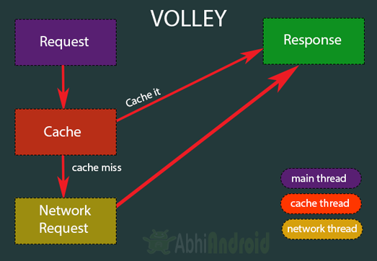
Working

Slide 5
Implementation
Include the following code in gradle (app level)
dependencies {
...
implementation 'com.android.volley:volley:1.1.1'
}

Slide 6
Creating Queue of Requests
RequestQueue queue;
queue = Volley.newRequestQueue(this);
queue.add(req);
req is JsonObjectRequest obeject

Slide 7
Creating JsonObjectRequest object
JsonObjectRequest req = new
JsonObjectRequest(Request.Method.POST,
url,
data,
successHandler,
ErrorHandler);
Data should be in json

Slide 8
Success And Error Handler
Create success handler by implementing
Response.Listener<JSONObject>
Create error handler by implementing
Response.ErrorListener

